Slide 1


Marathwada Mitra mandal’s
COLLEGE OF ENGINEERING
Karvenagar, Pune
An Autonomous Institute
Presentation
On
DEPARTMENT CALENDAR

Slide 2
Group Information
Sr.No | Prn No | Name of students
1 | B24IT1051 | Sairam Pampatwar
2 | B24IT1053 | Ranveer Shinde
3 | B24IT1059 | Varad Rajboinwad
4 | B24IT1127 | Aditya Patil

Slide 3
Outline:
Introduction
Research
Analysis
Ideate
Build
Test
Implement
Links
reference

Slide 4
Introduction
Content:
A web-based solution for managing department appointments and schedules.
Allows users to view a calendar, add events, and get reminders.
Built using HTML, CSS, and JavaScript.
Key concepts: date manipulation, user input processing, and reminders.

Slide 5
B. RESEARCH
Research on similar tools: Features, shortcomings, and user needs.
Tools explored: Google Calendar, Microsoft Outlook, and others.
User pain points: Lack of reminders, complex interfaces, limited customization

Slide 6
C. Analysis
Target audience: Department members needing schedule management.
Challenges: Dynamic date manipulation, user-friendly interface, and reminders.
Proposed solution: An interactive and responsive calendar tool.

Slide 7
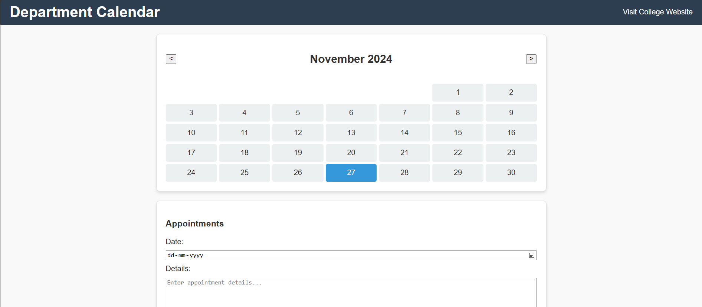
D.Ideate
Brainstorming solutions:
Monthly/Weekly/Daily views.
Appointment reminders.
User-friendly navigation.
.

Slide 8
E. Build
Development phases:
UI Design: HTML and CSS for layout and responsiveness.
Functionalities: JavaScript for date handling and event reminders.
Integration: Storing data with localStorage.
Tools used: VS Code, Chrome Developer Tools, Git.

Slide 9
F.Test
Testing methodologies:
Functional testing: Adding events, reminders, and navigation.
Responsive testing: Ensuring compatibility with mobile and desktop views.
User feedback: Beta testing within the department.
Summary of test results: Performance, usability, and improvements.
Include charts or bug-test results.

Slide 10
G.Implement
Deployment: Hosting the project (e.g., GitHub Pages or Netlify).
User training and onboarding.
Post-deployment support plan.

Slide 11
H. Links
1.Upload Video Link Here
2.Upload Blog Link here
3. Upload Project Link here (Classroom Link and Github link)

Slide 12
Reference
Ex.
[1] I. Thompson, “Women and feminism in technical communication,” J. Bus. Tech. Commun., vol. 13, no. 2, pp.154–178, 1999.
[2] Online Links
[3] video links

